Slide 1
Renal Dysfunction in a 42-year-old Obese man:
A Family Medicine Approach
Iman Kiani
Dr. Ghorbani, MD Nephrologist

Slide 2
Case Presentation
42-year-old male, no known past medical history
Family history: diabetes mellitus
Presenting to family medicine clinic for routine visit
Vitals: BP 145/90 mmHg
Anthropometrics: Weight 112 kg, Height 180 cm → BMI 34.6 (Obese class I)
Examination: No edema, heart and lung auscultation normal

Slide 3
Laboratory Findings
Serum creatinine: 1.0 mg/dL
Urinalysis: Protein 1+, RBC negative, WBC negative Urine
ACR: 170 mg/g
Serum uric acid: 8.9
FBS: 91
HbA1c: 5.3%
ALT: 35
AST: 28

Slide 4
Problem List
Obesity class I (BMI 34.6)
Stage 1 hypertension (ACC/AHA) or Grade 1 hypertension (ESC 2024) - newly diagnosed, needs confirmation
No evidence for DM
CKD staging: G1A2 - CKD IS present (normal eGFR but albuminuria >30 mg/g qualifies per KDIGO)
Moderately increased albuminuria (ACR 170 mg/g, category A2)

Slide 5
Confirming the Diagnoses
Hypertension
Single office reading of 145/90 is insufficient for diagnosis
Confirm with ambulatory BP monitoring (ABPM) or home BP monitoring (HBPM) over 3–7 days (ESC 2024, AHA 2025)
Rule out white coat hypertension

Slide 6
Confirming the Diagnoses
BMI
BMI = Weight / Height² = 112 / (1.80)² = 34.6 kg/m² -> WHO Classification: Class I Obesity (30.0–34.9)
BMI underestimates adiposity in some populations -> waist circumference (>102 cm in men = central obesity)
eGFR
CKD-EPI 2021 (race-free equation), male, age 42, Cr 1.0 mg/dL → eGFR ≈ 92–93 mL/min/1.73m² → KDIGO category G1
eGFR may overestimate true GFR in obese patients - higher muscle mass and increased creatinine production from greater body size can inflate the denominator.
Cystatin C-based eGFR is more reliable in obesity if clinical suspicion warrants it.

Slide 7
Confirming the Diagnoses
Albuminuria
A single ACR of 170 must be confirmed on repeat testing (at least 2 of 3 samples over 3 months per KDIGO 2024)
Consider timing: first morning void preferred
In obese patients, higher creatinine excretion rate can underestimate true albumin excretion - ACR may actually underestimate the degree of albuminuria.

Slide 8
Why Does Albuminuria Matter Here?
ACR 170 mg/g in a patient without diabetes, with hypertension and obesity-differential includes:
Hypertensive nephrosclerosis (most likely given clinical picture)
Obesity-related glomerulopathy
Early diabetic nephropathy (family history of DM)
Primary glomerular disease (less likely: no hematuria, no edema, normal creatinine)
Even with normal eGFR, moderately increased albuminuria independently predicts: cardiovascular events, CKD progression, and all-cause mortality

Slide 9
Additional Workup to Consider
HbA1c or fasting glucose (screen for diabetes given family history and obesity)
Fasting lipid panel (CV risk stratification)
Serum electrolytes, calcium, phosphate (baseline for CKD monitoring)
Consider renal ultrasound (rule out structural abnormality, assess kidney size)
ECG (assess for LVH as target organ damage)
Fundoscopy (hypertensive retinopathy screening)
10-year CV risk calculation (SCORE2 for European guidelines or PCE for ACC/AHA)

Slide 10
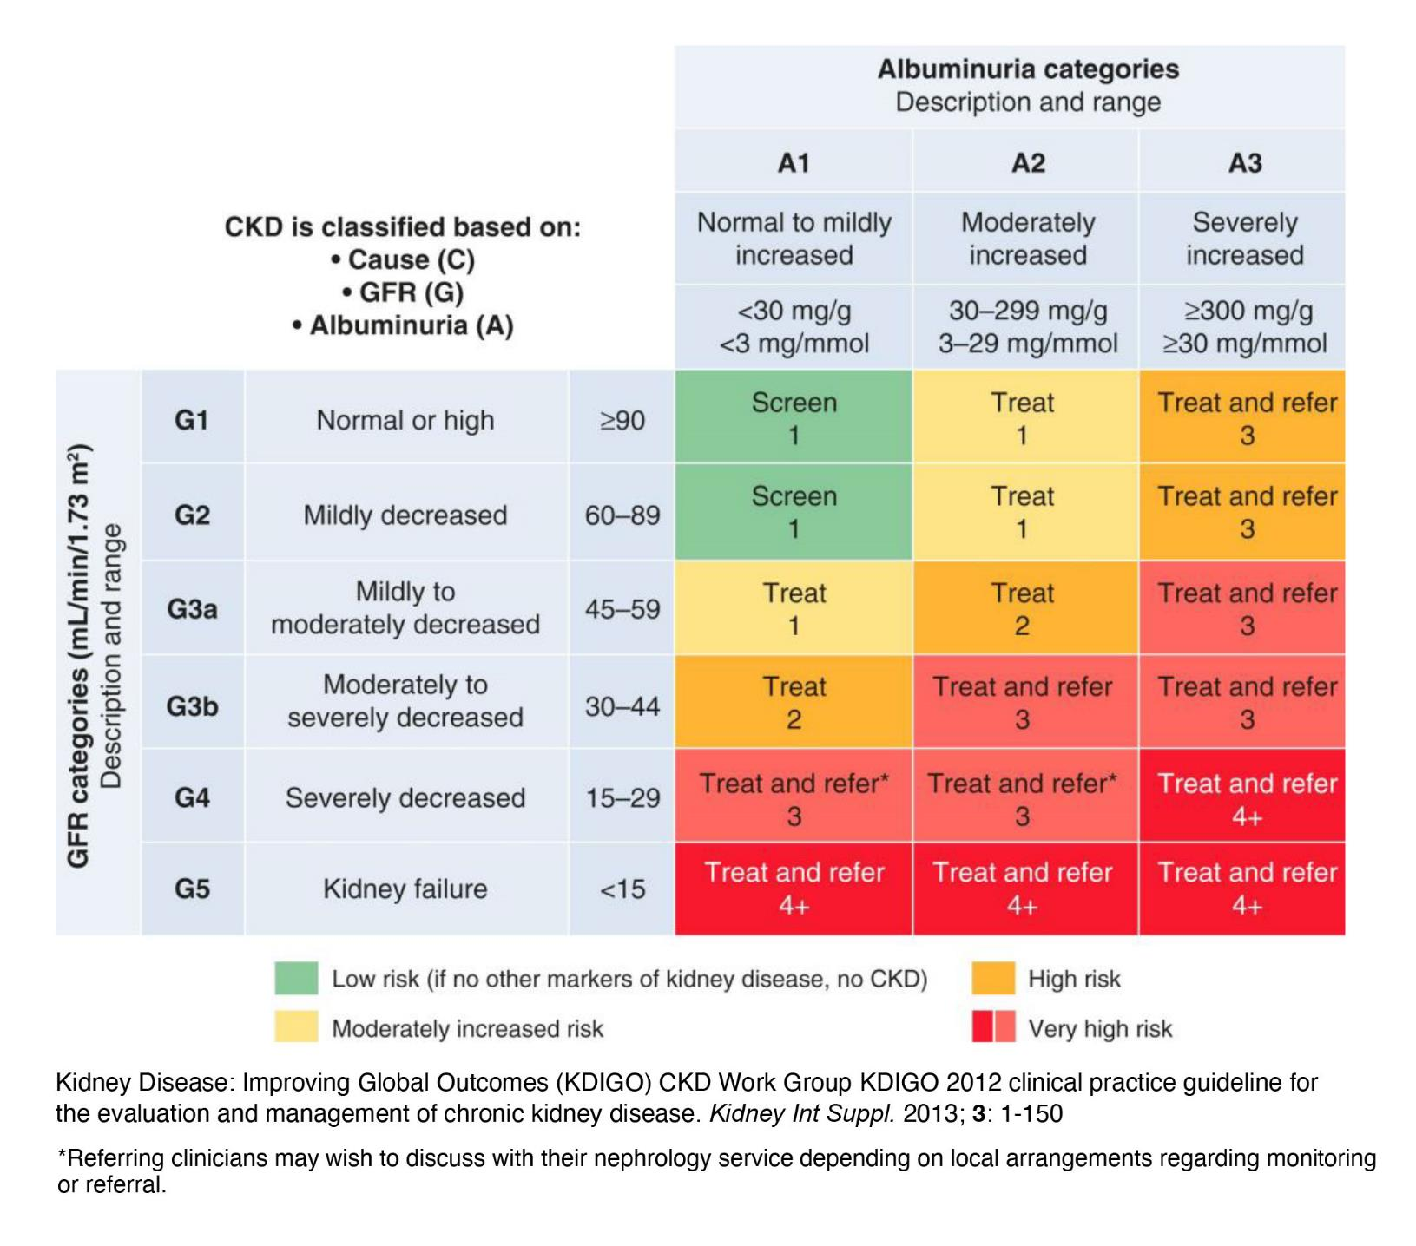

Slide 11
Management: Lifestyle Modifications
Weight loss: Target ≥5% body weight reduction - improves BP, albuminuria, and metabolic profile simultaneously
Dietary: DASH diet, sodium restriction (<2g/day), potassium enrichment Exercise: ≥150 min/week moderate-intensity (per KDIGO 2024) Alcohol and smoking: assess and counsel
These are first-line for ALL the problems on the problem list - hypertension, obesity, albuminuria, and hyperuricemia

Slide 12
Pharmacological Management
Hypertension + Albuminuria A2 without diabetes:
KDIGO 2024 SUGGESTS initiating ACEi or ARB (Level 2C)
This patient has a dual indication: BP lowering AND albuminuria reduction
ACEi/ARB is therefore the clear first-line antihypertensive here
Target BP: <130/80 mmHg (both ESC 2024 and AHA 2025 align on this for CKD patients)
SGLT2 inhibitor:
KDIGO 2024 recommends SGLT2i for CKD with ACR ≥200 mg/g (1A) — this patient is at 170, just below
However, if albuminuria persists or worsens on ACEi/ARB, SGLT2i becomes strongly indicated
Also has independent benefits for weight and CV risk in this patient
Monitor: Recheck creatinine and potassium within 2–4 weeks of ACEi/ARB initiation. Continue unless creatinine rises >30%.

Slide 13
Follow-Up Plan
Short term (2–4 weeks)
Confirm BP with ABPM/HBPM
Recheck creatinine and potassium after ACEi/ARB initiation
3 months
Repeat ACR (need ≥2/3 abnormal results to confirm CKD)
Recheck eGFR
Review HbA1c result
Assess lifestyle modification adherence and weight
Ongoing
KDIGO heat map: G1A2 = monitor eGFR and ACR 1–2x per year
Reassess CV risk annually
If ACR rises above 200 or eGFR declines, escalate therapy (SGLT2i, consider nephrology referral)

Slide 14
How Does Obesity Damage the Kidney?
Hemodynamic pathway: Obesity causes glomerular hyperfiltration: increased renal plasma flow and intraglomerular pressure. Initially eGFR appears high-normal or even elevated, but this is maladaptive. Over time, the hyperfiltration leads to podocyte injury, glomerulomegaly, and focal segmental glomerulosclerosis (obesity-related FSGS).
Metabolic pathway: Adipose tissue secretes adipokines, inflammatory cytokines (TNF-α, IL-6), and leptin. These drive chronic low-grade inflammation, insulin resistance, and oxidative stress, all of which damage the glomerular endothelium and tubular cells independently of diabetes.
Mechanical/hormonal pathway: Visceral fat activates the renin-angiotensin-aldosterone system (RAAS) and sympathetic nervous system, contributing directly to hypertension and sodium retention, both of which compound kidney injury.
The convergence in this patient: obesity is simultaneously driving his hypertension, his albuminuria, and his hyperuricemia. Weight loss is not just "lifestyle advice”, it's treating the root cause of all three.
Clinical evidence: Even 5–10% body weight reduction has been shown to significantly reduce albuminuria and intraglomerular pressure in obese patients, independent of BP changes.

Slide 15
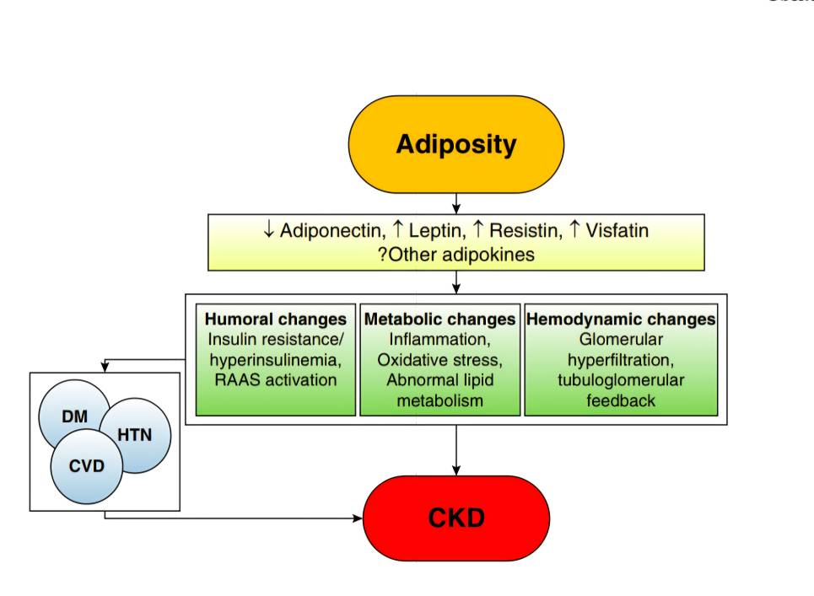

Slide 16
Key Takeaways
Albuminuria without reduced eGFR IS CKD - don't be falsely reassured by a normal creatinine.
In a young obese hypertensive patient, ACR screening catches early kidney damage that creatinine misses.
ACEi/ARB is the cornerstone when hypertension and albuminuria coexist.
Lifestyle modification addresses every problem on this patient's list simultaneously.
Family medicine is where these patients are caught early - before they reach the nephrologist.

Slide 17
Thank you for your attention!

